Slide 1
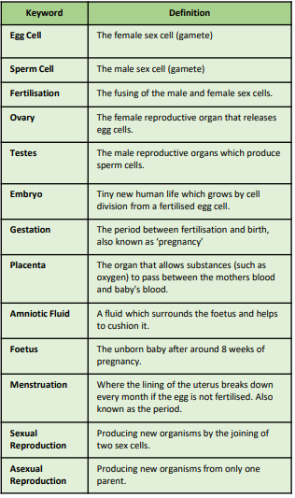
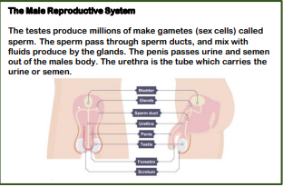
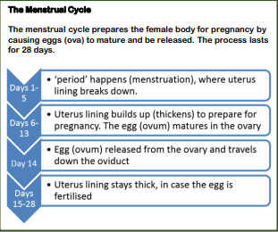
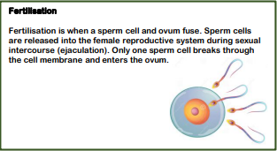
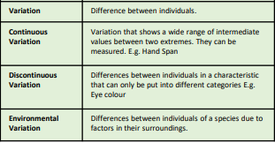
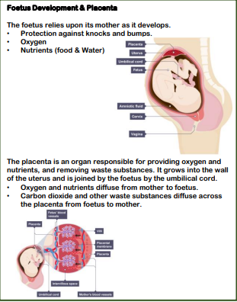
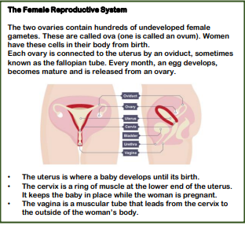
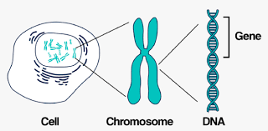
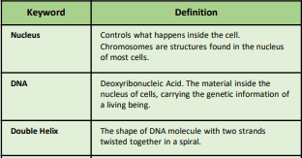
Unit 8.4 Reproduction &
Inheritance KO

Slide 2
 | Summary Questions | Answers
1 | Where is the DNA found in a cell?
2 | What are chromosomes made up of?
3 | What is the shape of a DNA molecule?
4 | What are gametes?
5 | Which organ produces the sperm cells?
6 | Which organ produces the egg cells.
7 | How does the semen get out of the male's body?
8 | What is an embryo?
9 | What happens during fertilisation?
10 | What is a foetus?
11 | Where does the baby grow in the mother?
12 | What does the foetus rely upon its mother for?
13 | What is the placenta is responsible for providing?
14 | Briefly describe what happens during the menstrual cycle.
15 | Which ring of muscle keeps the baby in place while the woman is pregnant?
16 | What does variation mean?
17 | What is continuous variation?
18 | What is discontinuous variation?
19 | What is environmental variation?
20 | What is the difference between sexual and asexual reproduction?

