Slide 1

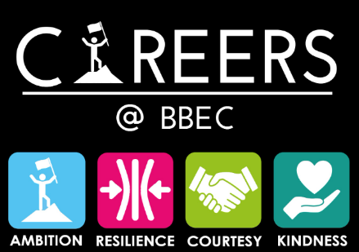

Y11 VIP Series “Vocational Courses”.

Slide 2
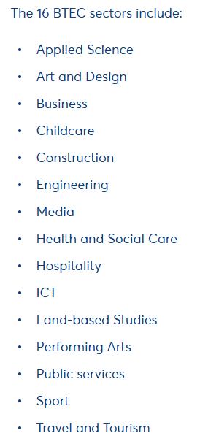
Do Now
Write down the names of some of the different sectors where people work e.g. sports, science…..
Share these with the person next to you.

Slide 3
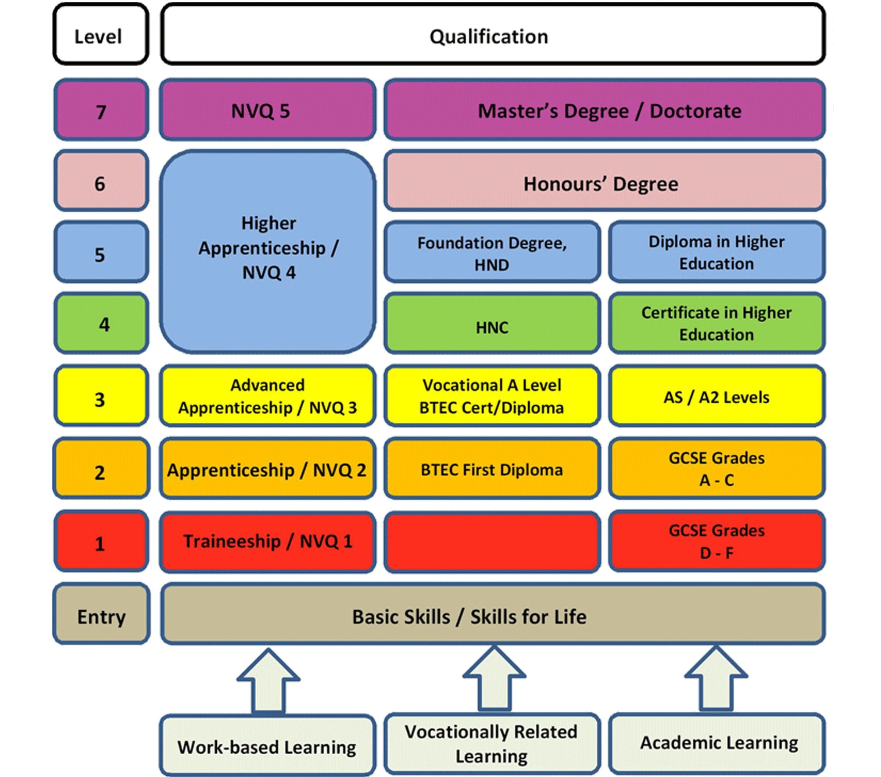

T levels /

Slide 4
T levels
T levels are a career-focused qualification for 16-to 19-year olds, equivalent to taking three A levels.
There are now over 20 T level subjects to choose from, including digital business services, educational and childcare, health, onsite construction, legal services, and craft and design.
They’re a mix of classroom learning and on-the-job experience that take two years to study.

Slide 5
T levels
Classroom Learning: A significant portion of the course (around 80%) is delivered in a learning environment
Practical Experience: The remaining 20% is dedicated to the industry placement, where students put their classroom learning into practice - this is equivalent to 1 day per work of work experience.
T Levels have the same UCAS points value as three A Levels, meaning they can be used to apply for university. However, they are not accepted by all Universities and there can be some issues with applications to Russell Group Universities.

Slide 6
T levels
T Levels are assessed through a combination of externally set written exams, an employer-set project, and synoptic assignments for the occupational specialism. All core exams, employer-set projects, and synoptic assignments are set and marked by the awarding organisation (the Examination Board).
The grade range for T Levels is A* to E, the same as A Levels

Slide 7
T levels
Employer-Designed Curriculum: T Levels are developed in collaboration with employers and industry to meet their needs.
T-levels are Level 3 qualifications and so normally require GCSE passes at grades 4+ in English and mathematics. However, for students not achieving the entry requirements they may be switched to a T-level Foundation Year a one-year post-GCSE study programme which provides essential preparation by developing English, maths, and digital skills, along with practical experience and personal development, to ensure they can succeed on a T Level. This would mean an extra year at College.
Video link

Slide 8

T-levels recall quiz
Write down as many facts as possible from the previous 3 slides and the video.

Slide 9
Applied General Courses
There seem to be many names for these courses, commonly BTEC Diploma. There are more than 2000 different courses available in 16 sectors.

Slide 10
Applied General Courses
BTECs from these 16 categories are split into four levels of study, organised similarly to GCSEs:
1. BTEC Firsts –The Firsts category starts at entry-level and ranging to Level 2. BTEC Firsts give you an introductory taste of a field, enabling you to decide if it is the right path for you. When combined with other qualifications, they allow you to move on to further study, employment, or into an apprenticeship.
2. Next Generation BTEC Firsts – These are a newer level of qualification introduced in 2013. The subjects available at this level include Business, Health and Social Care, and Children’s Play, Learning and Development, all at Level 1 and Level 2. They have been specifically designed to develop your skills in the workplace, giving you a strong foundation in your chosen sector.
Both these courses are accessible for students not achieving GCSE grades 4+ in English and mathematics.

Slide 11
Applied General Courses
BTECs from these 16 categories are split into four levels of study, organised similarly to GCSEs:
3. BTEC Nationals – BTEC Nationals range from Level 3 (which is a comparable standard to A levels). There is an Extended Diploma equivalent to three A-levels - so getting the highest grades of Dist*, Dist* and Dist* scores 168 UCAs points which is the same as A*,A* and A* at A-levels. There is also a National Diploma equivalent to two A-levels and a Subsidiary Diploma equivalent to one A-level.
4. BTEC Apprenticeships – If you want even more hands-on experience, a BTEC Apprenticeship is available in more than 25 sectors, from Levels 2 to 5.
Both these courses are accessible for students achieving GCSE grades 4+ in English and mathematics.

Slide 12
Applied General Courses
BTEC qualifications give you the chance to do a lot of practical and ‘hands-on’ work alongside your studies, while A level courses include more lectures, exams, oral presentations, and written essays. BTEC’s are set within a vocational context to help you learn about and enter a specific sector.
BTEC’s have continuous assessments rather than examinations just at the end of the courses. These assessments. through a combination of internally and externally marked units, with the majority being internally assessed by teachers or tutors through assignments, projects, or tests. Each unit is graded as Pass, Merit, or Distinction, and these individual unit grades are then used to calculate the overall qualification grade, often through a points-based system.

Slide 13
Applied General quiz
Write down as many facts as possible from the previous 3 slides.

Slide 14



Applied General quiz
Write down one differences between T levels and BTEC’s?
T-levels include 20% work placements
BTEC’s focus more on sectors
BTEC’s are more flexible
?
?
?
T levels are a newer qualification
There are many more BTEC subjects
BTEC has entry levels

Slide 15
Further work
Research one T-level and one BTEC course and look at a number of key areas:
What you study?
How you will study, is it all classroom-based?
How you will be assessed and tested?
What careers link well with each of those A-levels.

Slide 16

Please use this link below or the QR code to give us feedback on the lesson and suggest any improvements or additions.
https://forms.office.com/e/TXBtt1aDkc

