Slide 1



Y11 VIP Series “Writing a CV or Resume”

Slide 2

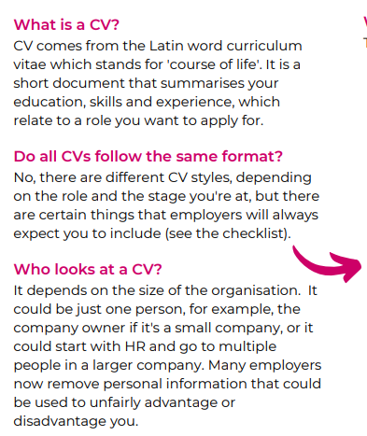
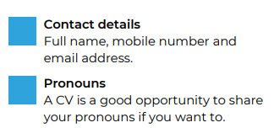
We suggest using your legal name that matches exam certificates and birth certificates or ID.
You can use parent/guardian mobile numbers and emails
Remember professional language and use a sensible email…so no “mysockssmell@gmail.com”
Only use your BBEC email if you check it regularly, but it is a good one to use.

Slide 3
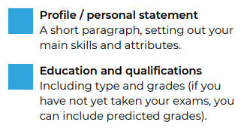
Unifrog has done your Personality and Skills Quizzes, highlighting your strengths. Make use of this information.
Get help here from people who know you and your strengths.
Use predictions from mocks and factor in all that extra revision you will do this year!

Slide 4
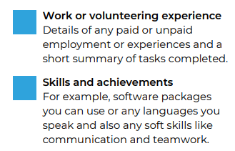
Include experiences added by school to Unifrog e.g. World of Work.
Include experiences outside of school, everything counts and if you are in doubt ask for help.

Slide 5
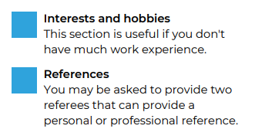
What you do in your free time says a lot about you.
Include experiences in school e.g. Prefects, Clubs and Teams and events you have taken part in.
This is often your form tutor or a member of staff who knows you very well. You may also ask Mrs Carr or the Careers Department
This has to be somebody credible, not a best mate! They can be from outside of school that you know in a professional capacity.

Slide 6
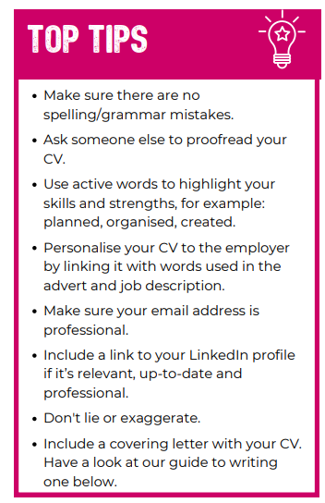
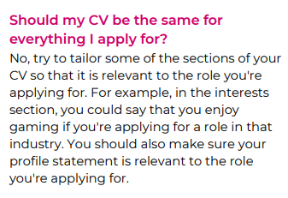
We will do this in the next lesson

Slide 7
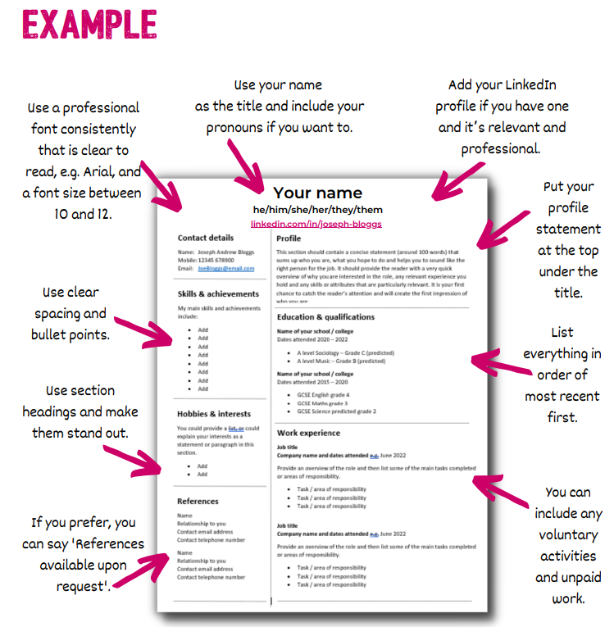
There are plenty of templates available online and Unifrog can also make your CV.

Slide 8

Case Study
Look at the two examples of CVs.
As an employer, which would you choose and why? Evaluate the strengths and weaknesses of both CV’s.

Slide 9
Further work
Use a template like the “Good CV” and from slide 7:
Start writing down the key information you will include in each section, if you have a laptop available use laptop.
Use Word to check the spelling and grammar and checked by a peer and a member of staff.
Save your CV as “<<Your name + CV>>. Make sit easier to find and for employers to know its yours.

Slide 10

Please use this link below or the QR code to give us feedback on the lesson and suggest any improvements or additions.
https://forms.office.com/e/TXBtt1aDkc

Slide 11


