Slide 1



Y11 VIP Series “Apprenticeships”.

Slide 2

Do Now
Write down anything you know about Apprenticeships.
Share these with the person next to you.
Everything you need to know about Apprenticeship can be found on www.amazingapprenticeships.com or this link
Now
Try the quiz on this link

Slide 3
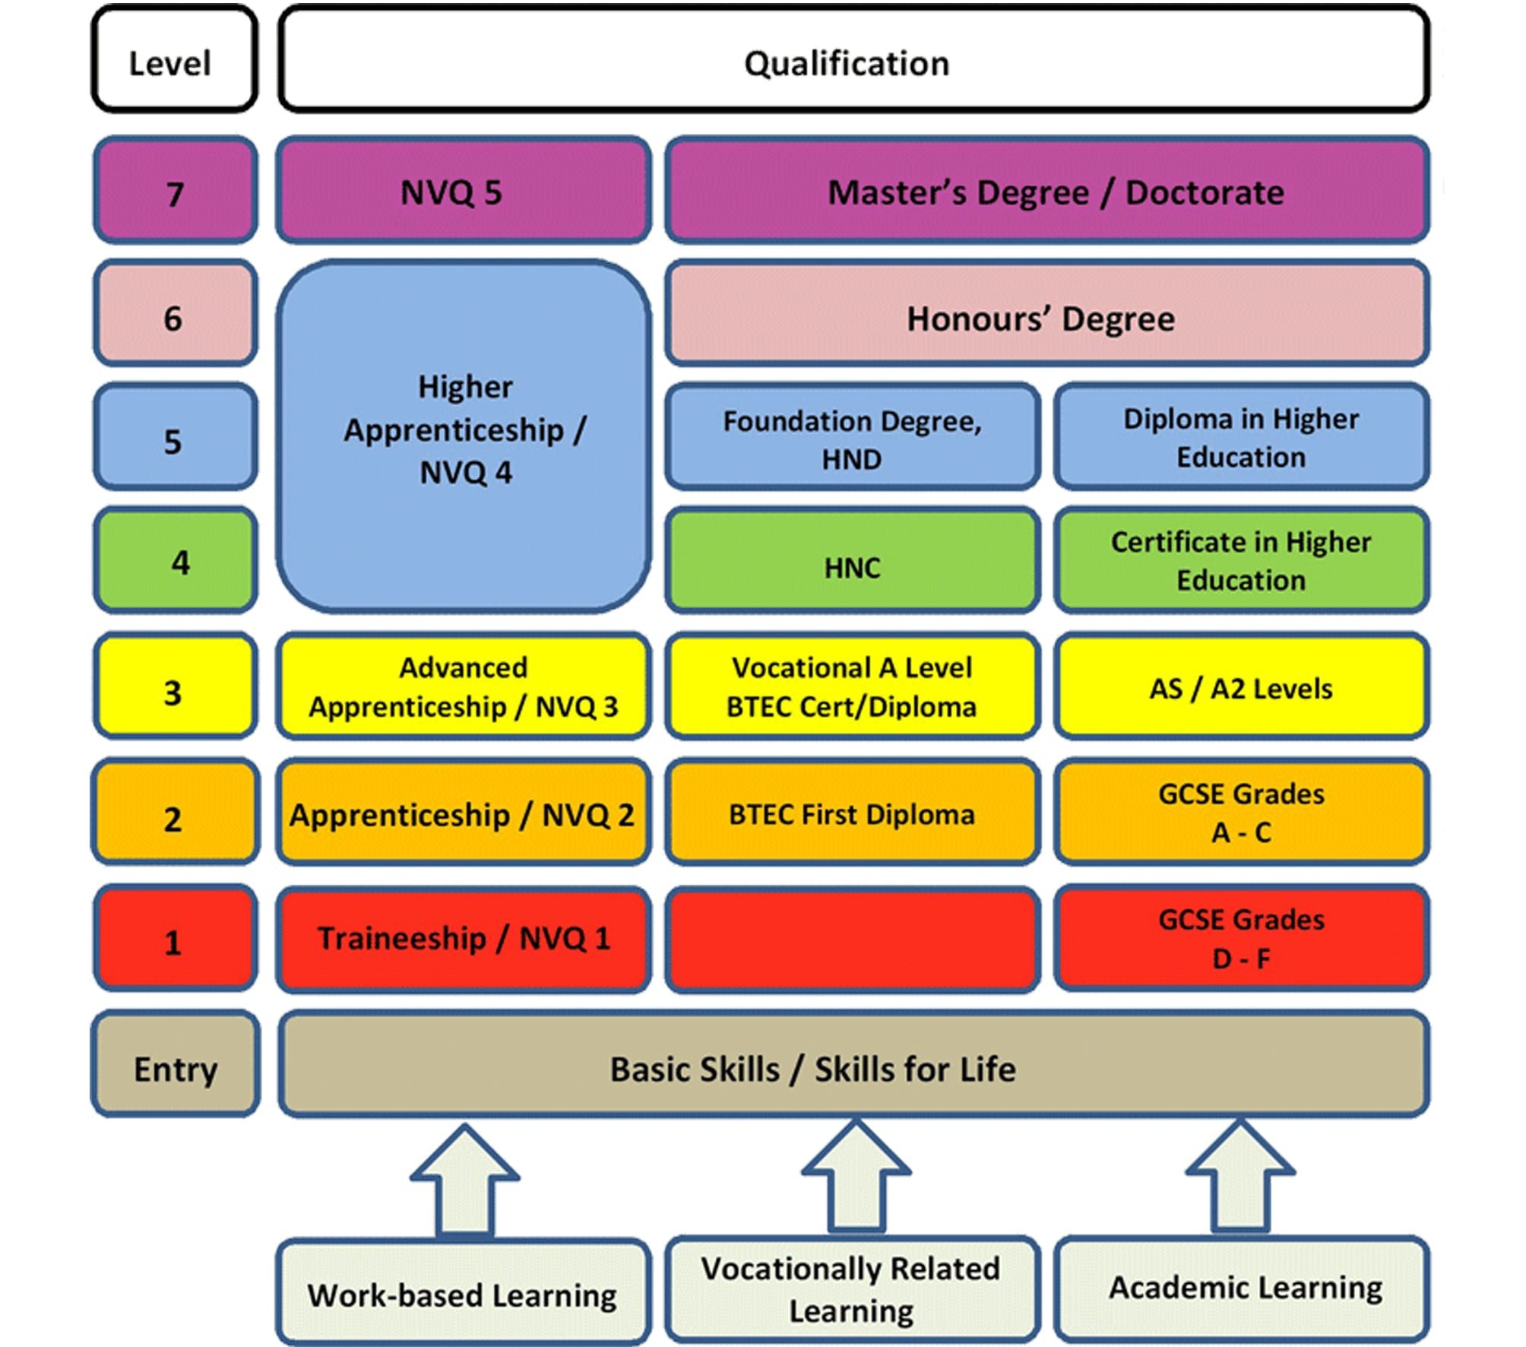

T levels /

Slide 4
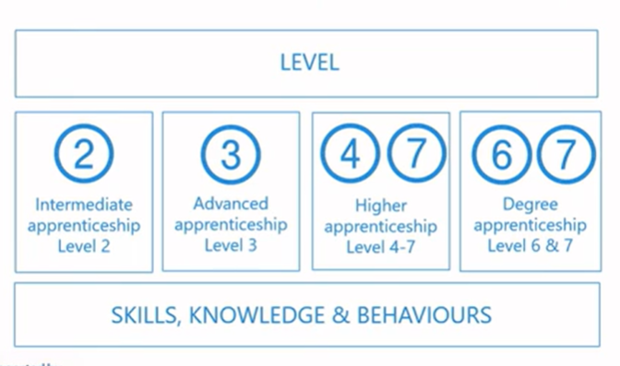
Apprenticeship
Buttershaw website has a lot of information on this link.
When you leave school at the end of Year 11 you may have the GCSE passes to consider either Level 2 Intermediate Apprenticeship or a Level 3 Advanced Apprenticeship.
You are paid during your Apprenticeship
and the rates vary.

Slide 5

Apprenticeships
How many hours a work can you expect to work as part of an apprenticeship?
10
20
30
40
Many vocational courses start at L1 as you would be starting a new subject. However, the student would still be required to study GCSE English and mathematics to try again to achieve L4 passes.

Slide 6
Applying for Apprenticeships
We encourage all students wanting to do an Apprenticeship to still have a back-up application at some different providers, This is because most Apprenticeships are advertised after Christmas and right up through the summer.
Applying for Apprenticeships is also competitive, you will be going against other people wanting the same apprenticeship – so there are no guarantees.

Slide 7
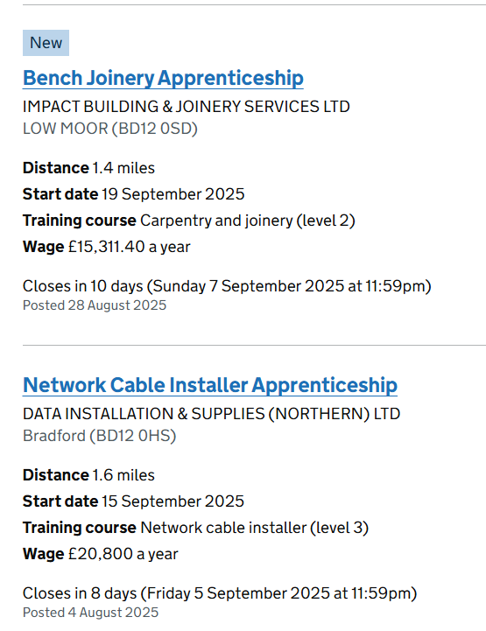
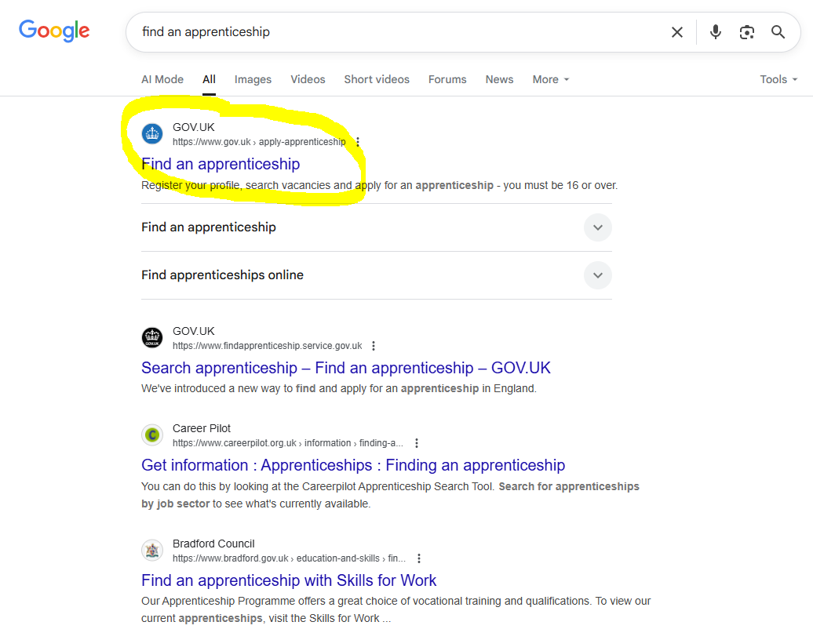
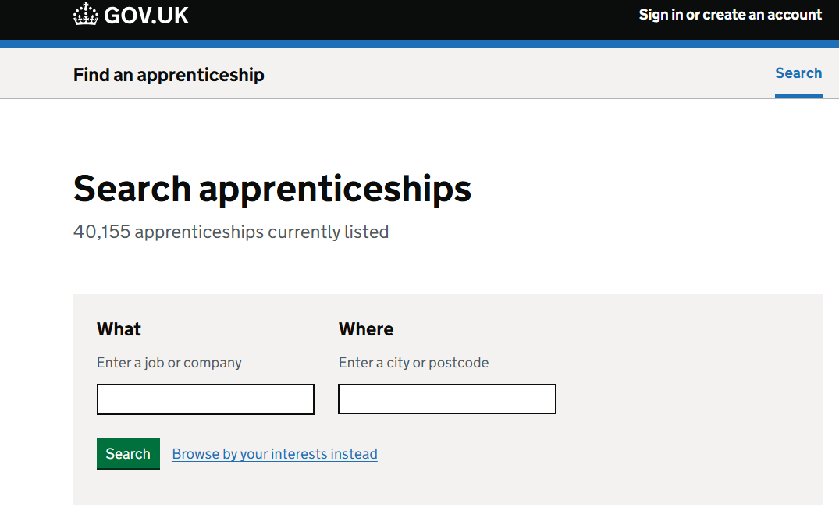
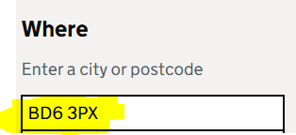
Applying for Apprenticeships
The Government Website is a good place to start, register an account and start searching.
Here is a useful link also from the BBEC website link
Notes:
Search apprenticeship – Find an apprenticeship – GOV.UK

Slide 8

Applying for Apprenticeships
West Yorkshire Learning Partnership(WYLP) has some great links to Apprenticeships across our region.
Here is a useful link
Notes:
Apprenticeships - The Yorkshire Apprenticeship Service

Slide 9
Further work
Research one T-level and one BTEC course and look at a number of key areas:
What you study?
How you will study, is it all classroom-based?
How you will be assessed and tested?
What careers link well with each of those A-levels.

Slide 10
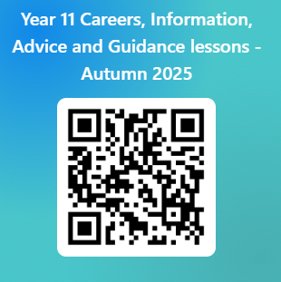
Please use this link below or the QR code to give us feedback on the lesson and suggest any improvements or additions.
https://forms.office.com/e/TXBtt1aDkc

