Slide 1
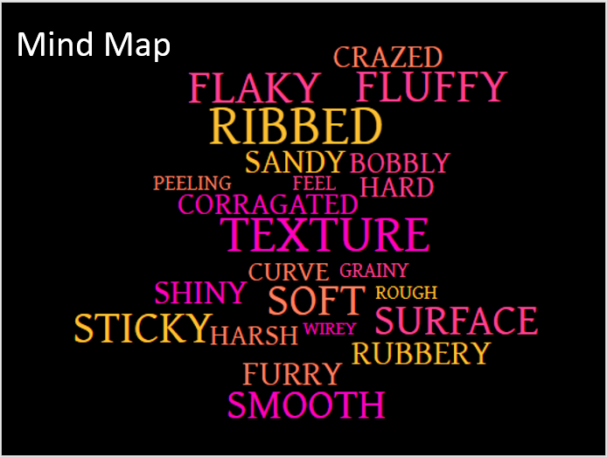
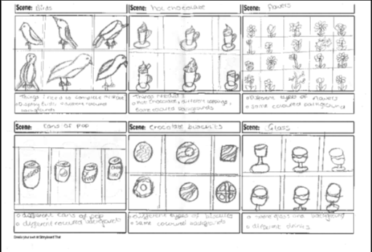
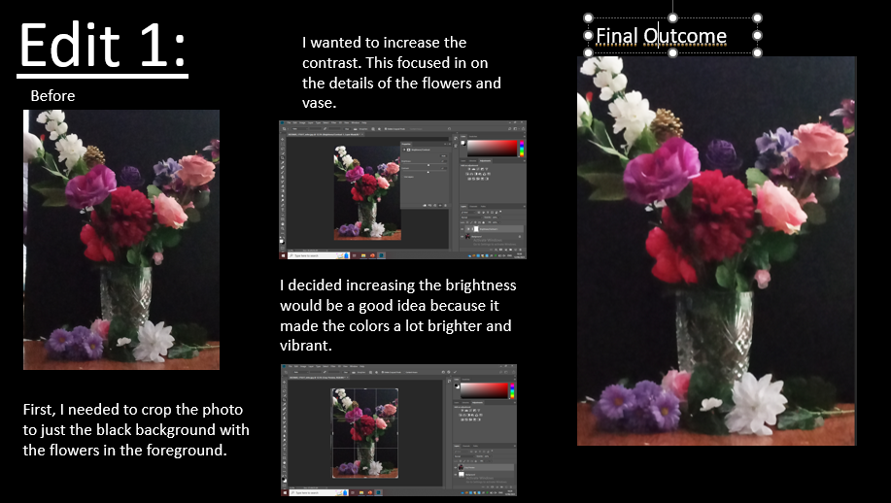
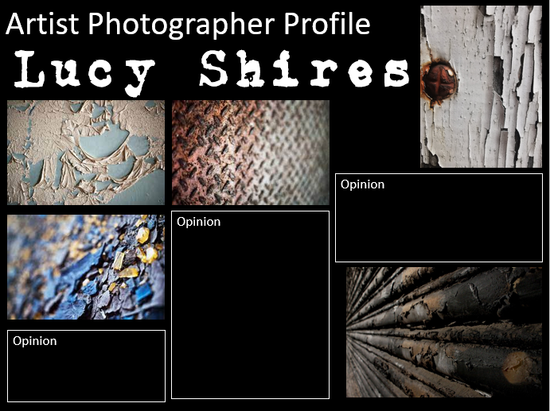
Year 11 GCSE Photography Learn Sheet
AO2: Refine work by exploring ideas,
selecting and experimenting with
appropriate media, materials, techniques and processes.
AO1: Develop ideas through Investigations, demonstrating critical understanding of sources.
AO3: Record ideas, observations and insights relevant to intentions as work progresses.
AO4: Present a personal and meaningful response
that realises intentions and demonstrates
understanding of visual language.

