Slide 1



Y11 VIP Series “Choosing Providers

Slide 2

Think about the West Riding Area that surrounds BBEC, including Bradford, Leeds, Huddersfield, Halifax (Calderdale) and Wakefield.
Name as many possible providers of places to learn and record them on your whiteboard. Think about Colleges and Sixth Forms.

Slide 3
In a year’s time you will be somewhere else and your time at BBEC will have ended.
If you are considering full-time education somewhere else and possibly training through an apprenticeship you will have to think about the big question of where this might happen, which provider will you use?

Slide 4
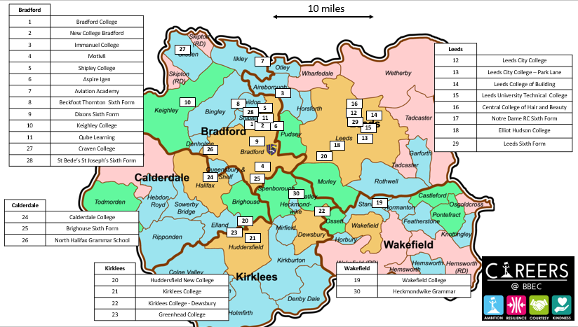

Slide 5
Think about the some of the factors that might impact which provider(s) you apply to?
Travel time (getting there and back everyday)
Travel costs (buses and trains fares)
Preferred Course
Reputation of the provider
Staying with friends
Parental guidance………………..
As a class can we think of more?

Slide 6
Which of these factors are most important to you?
Rank your top 5 factors:
1.
2.
3.
4.
5
Are any of these factors “non-negotiable”?

Slide 7
Travelling to and from a provider is a key consideration.
For example, the Aviation Academy at Leeds-Bradford Airport is an amazing provider of courses that allow you to become a Pilot or Air Crew. However, it might be a challenge getting there!
Do some research: link
Explore possibilities, does somebody you know work near the provider and how many days are you at the provider (some courses are only 3 days per week).

Slide 8

True or False?
I can only apply to one provider in the West Riding?
True
False
You can apply to as many different providers as you like?

Slide 9
True or False?
If you live in Bradford, you must study in Bradford?
True
False
There are also many ways of accessing support for travelling out of Bradford, with many providers and organisations offering support for transport costs.

Slide 10
True or False?
I can only apply to one course at each of the providers?
True
False
Most Colleges allow you to apply for more than one course, whilst you are likely at Sixth Form providers to submit just once application.

Slide 11
True or False?
If you have applied for a course at a College of Sixth Form you cannot change your mind at a alter date?
True
False
Ultimately, you will decide which course you want to study.
You might change courses at the same provider during the application windows or after results day, for example, changes to your level of course. You can even make a new application after results day.

Slide 12
True or False?
It is better to wait until you get your results and then apply
True
False
There is a lot of competition for many providers and many courses, and the available quotas will fill up quickly on the most popular ones e.g. A-levels sciences and maths, trades and sports sciences.
Also get you applications done by Xmas and you can then focus solely on your examinations.

Slide 13
True or False?
You must do your own application
True
False
Doing applications is a new thing and it can be difficult. There is help available and make use of it, especially the BBEC Careers department of Mr Ryan and Ms Kauser – based on Green 0. They can guide and help you do applications and arrange live sessions with providers and external Careers Advisors.

Slide 14
How do you find out more about the different Providers and inform your choices?

Slide 15
How do you find out more about the Providers and inform your choices?
Word of Mouth
Friends and Family
Social Media
Internet and Webchats
BBEC Careers and Assemblies
BBEC Aspirations Event
Virtual Tours
Campus Tours at your convenience
Visits to Provider Open Days
Some of these are more reliable than others!

Slide 16
Researching post-16 pathways (5 mins)
Look at the sources of information below. How many have you used to help you find out about options after secondary school? Label each information source:
YES: if you have used it
WILL USE: if you intend to use it, but haven’t yet
NO: if you don’t intend to use it
Conversations with careers advisors, teachers, or other school staff
Conversations with parents / carers
Conversations with friends
Conversations with older siblings or friends who have already left school
Conversations with professionals in the career sector you want to work in
Information provided by your school
Information provided by local colleges, sixth forms, or employers
Independent research using Unifrog
Independent research using other trustworthy websites
Independent research using social media or blogs
Notes:
Teacher’s notes:
The purpose of this activity is for students to consider the sources of information available to them whilst researching post-16 pathways. Students are to note down whether or not they have made use of these sources of information yet, considering their potential usefulness. E.g. 1 = YES.
Stretching activities:
Select the information source you think you’d find the most useful and explain why.
Where else could you look for information about post-16 options?
Suggested answers:
Students will have their own opinions about which sources of information they find trustworthy and accessible. They may wish to consider the following:
Conversations with others: Talking to other people about your post-16 pathway options is usually a great idea! Just remember that someone else’s preference for the ‘right’ pathway may differ from your own preference. For example, most of your friends may be going to college, but you wish to do an apprenticeship. It’s important to select the pathway that’s right for you, not for other people.
Research using social media and blogs: Whilst there are some great career-based blogs, vlogs, and social media pages that exist, remember that anyone can create them – be aware of potential bias and always fact-check the content using reliable sources like the Unifrog Know-how library.

Slide 17
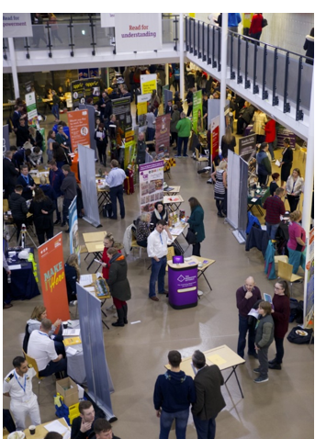
Aspirations Evening
This is on the 13th November between 5.30pm and 7.30pm.
It will be attended by most of the important providers and students, and their families are welcome to attend. There are normally over 40 stalls or providers, trainers and employers.

Slide 18
Open Days
Attend Open Days, even for providers who are not your first choice. This will both confirm you are making the right choice but also compare your own experiences of the buildings, staff, facilities and support available.
BBEC Careers will keep you updated about all things Careers through weekly bulletins to your tutor. Look out for Open Days.
.

Slide 19

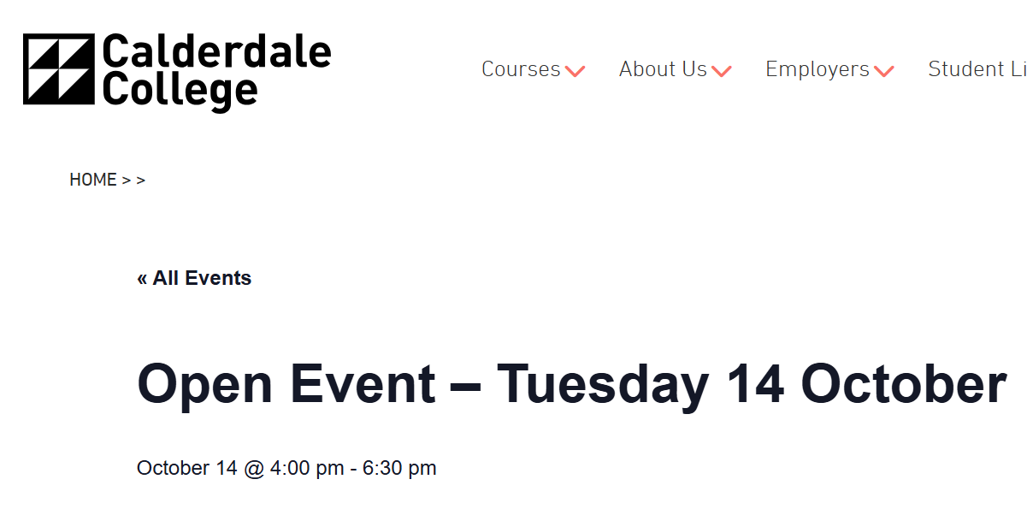
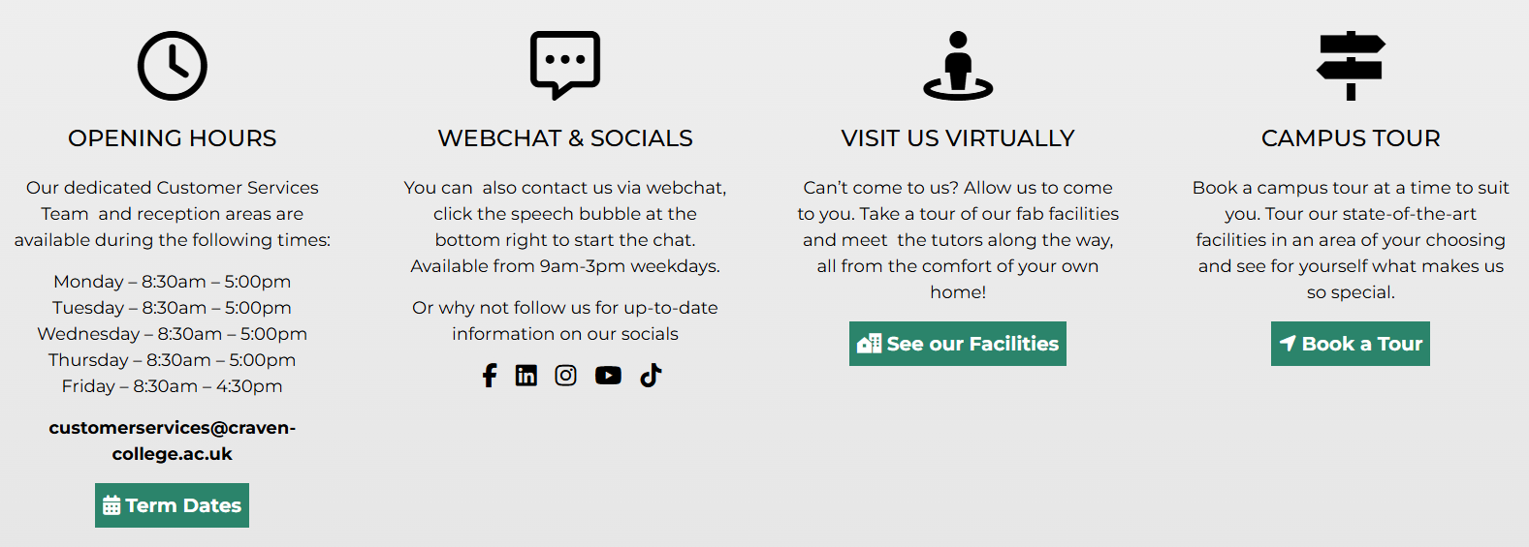

Slide 20
Furtherwork
Research two providers, one you are familiar with and have been considering and a second, one that is less familiar but a possibility.
Find out what you can about the factors we have discussed e.g. getting there, types of courses etc
How can you find out more about the providers, when are open days etc?

Slide 21
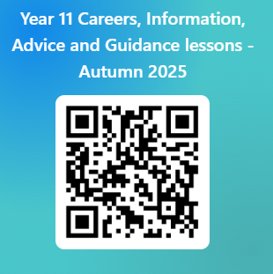
Please use this link below or the QR code to give us feedback on the lesson and suggest any improvements or additions.
https://forms.office.com/e/TXBtt1aDkc

Slide 22


