Slide 1

RE Series “Getting thru the Door”
Lesson #1: Language of Employability

Slide 2


Do now – What can we remember?
Last year | Last year | Last year
Give three post-16 options available to you when you leave school. | Name three colleges in your area which offer post-16 courses. | You would like to study a particular course next year. What things could should you be doing? For example: Find out what GCSE’s grades you need for the course. 1. 2. 3.

Slide 3
Do now – What can we remember?
Last year | Last year | Last year
Give three post-16 options available to you when you leave school. Stay in full-time education, e.g. at a college/sixth form, doing A Levels, T Levels or other academic qualifications. Start an apprenticeship. Work or volunteer for 20 hours or more a week while in part-time education or training. | Name three colleges in your area which offer post-16 courses. Sixth form colleges: New College Bradford Dixons Sixth Form Academy Colleges: Bradford College Shipley College Keighley College Craven College | You would like to study a particular course next year. What things could should you be doing? For example: Find out what GCSE’s grades you need for the course. 1. Visit the college/sixth form open day. 2. Complete an application form. 3. Write you CV. 4. Attend an interview.

Slide 4

Careers – How do I ensure I’m accepted for the course I would like to do?
Lesson intention: To understand the language of employability and the difference between formal and informal language.
Key terms:
Formal
Informal
Standard English
Slang
Professional
Learning outcomes:
All students will:
Understand how language varies based on context and audience, and how to use language appropriately in different professional settings.
Understand why formal language must be used in the world of work.
Looked a examples of informal and formal letter writing.
Star presentation:
Blue / black pen
Use a ruler
Check your SPaG
No graffiti
Highlight in yellow

Slide 5

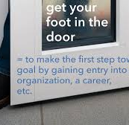
What will we be studying up to Christmas?
“Getting through the door”
Lesson 1: Language of employability / Formal v Informal Language and why first impressions matter.
Lesson 2 and 3: Finding part-time employment (volunteer/paid) – where to start? hours and wages and the law.
Lesson 4 and 5: Preparing for meeting on Teams and/or interviews.
Lesson 6: How to write a CV.
Lesson 7: How to write a Covering Letter / Email / Personal statement.
Notes:
Explain here in their VIP sessions they are going to be looking at what doors (courses) are available to them. In these sessions with us every two weeks until Christmas, they are going to be looking at how to get through the door, i.e. how can they ensure they get the course they want to do.

Slide 6

Key word check - Formal and informal - What does it mean?
In context: In his job interview, Sam ensured he used formal language and wore formal clothing.
On your handout, are two words with a similar meaning. One is formal and one is informal. Circle the word which uses formal language.
1. Ask / Enquire
2. Difficult / Tough
3. Book / Reserve
4. Check / Verify
5. Assist / Help
6. Get / Receive
7. Inform / Tell
8. Incorrect / wrong
9. Need / Request
10. Increase / Go up
Give examples of formal language for each of the following.
A. Say sorry - Apologise
B. Start - Begin
C. Lucky - Fortunate
On your handout, are two words with a similar meaning. One is formal and one is informal. Circle the word which uses formal language.
1. Ask / Enquire
2. Difficult / Tough
3. Book / Reserve
4. Check / verify
5. Assist / Help
6. Get / Receive
7. Inform / Tell
8. Incorrect / wrong
9. Need / Request
10. Increase / Go up
Give examples of formal language for each of the following.
A. Say sorry -
B. Start -
C. Lucky -
Copy down the meaning:
Formal: Following certain rules or expectations about how to behave, dress, or speak, especially in specific situations.

Slide 7
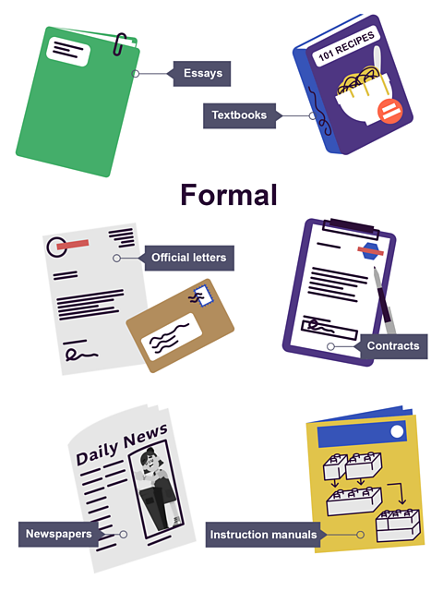
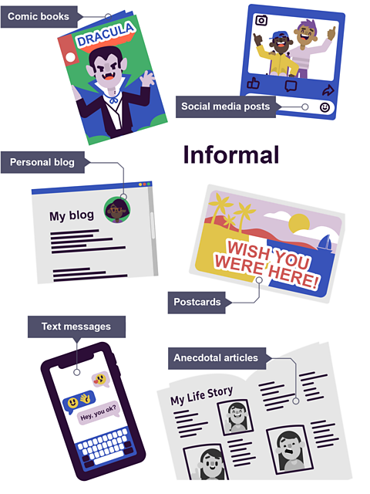
Formal versus informal writing - Read through the handout and answer the following questions on the sheet.
1.How could you define formal writing?
2.Describe the language used in formal writing.
3.Why might someone use formal writing?
4. Give four examples of formal writing.
5. Informal writing is more reflective of what?
6. Describe the language used in informal writing?
7. Give four examples of informal writing?
8. Why is it important to know when formal or informal writing is expected?

Slide 8
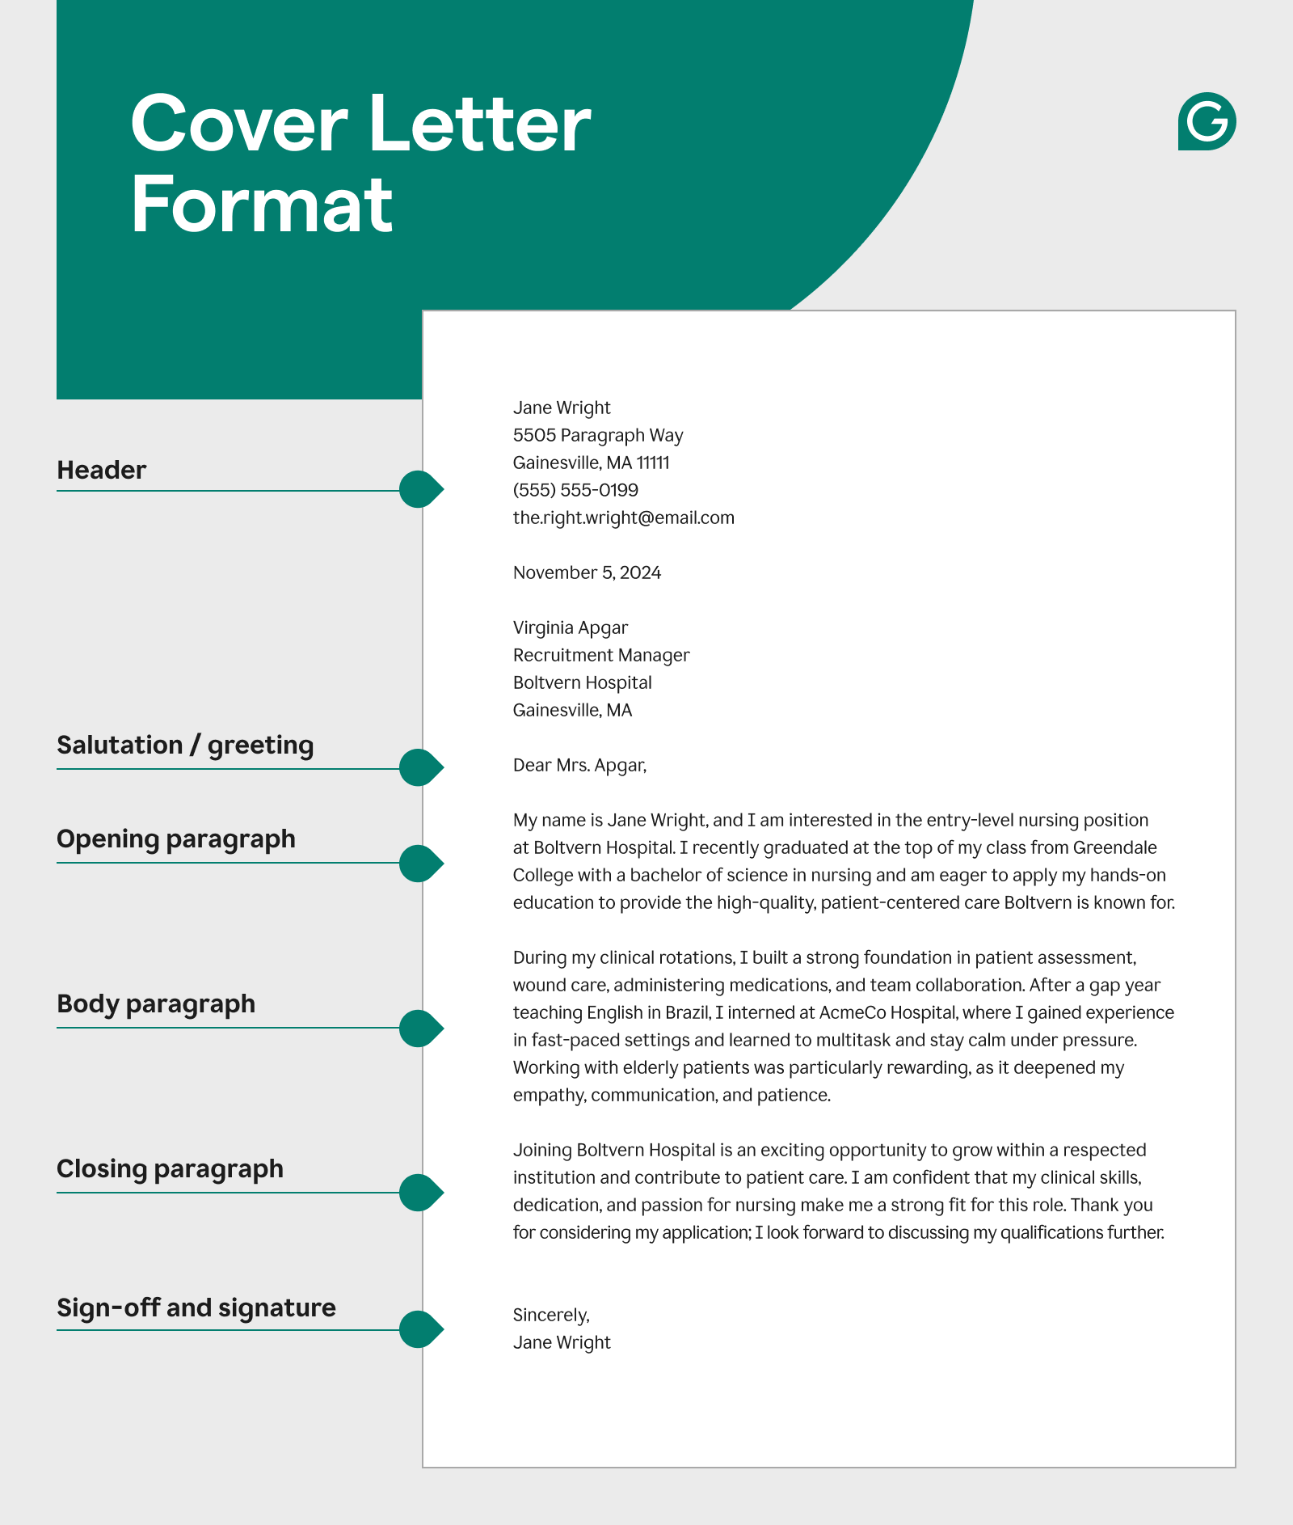
Letter of application –
Read through the example application.
After every example of informal language being used, add in a more appropriate formal example.
The first one has been done for you.

Slide 9
Letter of application
Dear Mike,
Dear [Mr./Mrs./Ms. Hiring Manager Last Name or Hiring Team],
Hope you're doing well! I'm writing to you because I saw the Builder Apprenticeship position on LinkedIn and it sounds like a great fit for me.
I would like to apply for your 2025 Level 3 Builder Apprenticeship Programme which I saw advertised on LinkedIn. This would be a great opportunity for me to combine practical, on-the-job learning whilst developing my knowledge in the classroom.
I'm Howard, and I'm a Year 11 student at BBEC. I have always wanted to be a builder, and I think your apprenticeship would give me a good head start.
I’ve just completed my GCSE’s where I have been predicted to gain a grade 5 and above in all my subjects, including a GCSE in Engineering.
Although I don’t have much experience, I have always been hands on and love fixing and building things. For example, I helped my Dad build our extension. I'm really excited about this opportunity, and I think I could bring a lot to your team.
I have always enjoyed fixing and building things. For example, I have helped relatives with building renovations and recently helped to build an extension where I gained hands-on experience in various construction tasks.
I'm eager to learn more about this course and chat with you about how I can contribute. Let me know when would be a good time to connect. I have attached my C.V for you to look at.
I would love the opportunity to discuss this further and have attached my C.V for you to consider.
Thanks, and talk soon! Best wishes,
Yours sincerely
Howard Smith
Howardsmith12@email.co.uk

Slide 10
Informal language face to face
Watch the following clip and spot as many examples of inappropriate informal language being used as you can. What could you replace them with?

Slide 11

Checking for understanding - MWB
1. What does the word formal mean?
2. Give examples of when formal language would be used.
3. Give two examples of when someone might use informal writing.
4. Why should you write using formal language in a letter of application for a job/course?

Slide 12

Please use this link below or the QR code to give us feedback on the lesson and suggest any improvements or additions.
https://forms.office.com/e/TXBtt1aDkc

