Slide 1

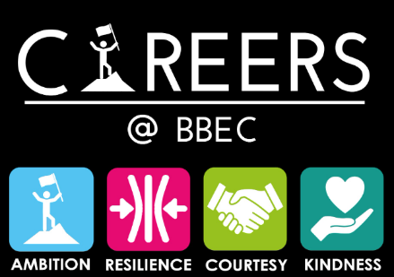

Y11 VIP Series “Academic Courses”.

Slide 2
Do Now
Write down what you know about A-levels and why so many students take them?
Share these with the person next to you.

Slide 3
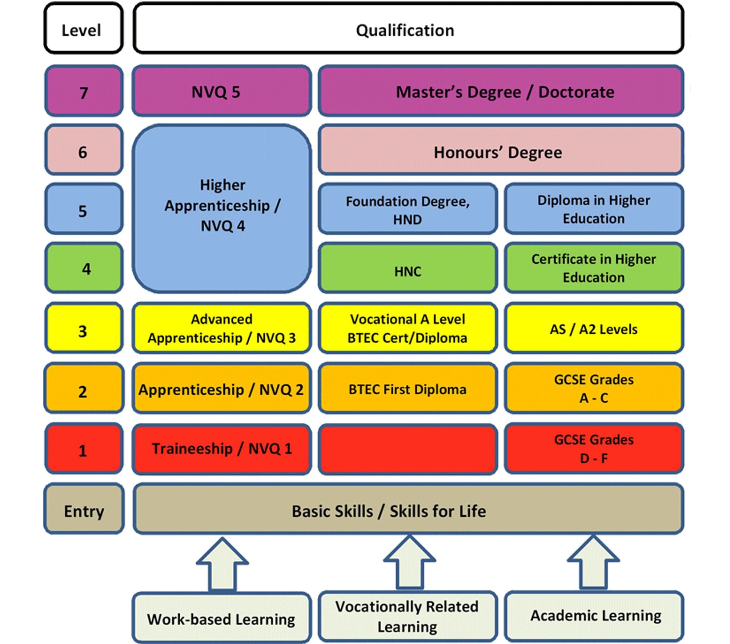

T levels /

Slide 4
Post-16 pathways: pros and cons
Full-time education | Employment | Apprenticeship
Full-time education | Employment | Apprenticeship
Full-time education | Employment | Apprenticeship
Full-time education | Employment | Apprenticeship
Draw a table like the example here.
In pairs or small groups, select one pathway and discuss the pros and cons of following this pathway.
Write down at least one pro and one con for your pathway and get ready to share your ideas with the class.
Note down what other pairs/groups say, so you all have a completed table.
Full-time education | Employment | Apprenticeship
Notes:
Teacher’s notes:
The purpose of this activity is to encourage students to compare the three pathways’ advantages and disadvantages. You may wish to allocate an equal number of pairs/groups to each of the three pathways, to facilitate effective whole-class discussion of ideas.
Suggested answers:
Full-time education
Gain qualifications
Earn UCAS points (facilitates being able to go to university)
Extra-curricular opportunities, e.g. student council, clubs and societies, volunteering, etc.
Can study a variety of subjects that interest you (or one subject in depth)
Keeps options open if you don’t know what job you’d like to do yet
Not earning a salary
Not applying knowledge and skills to a workplace (unless there is a placement as part of your course, e.g. T level)
Employment
Earn a salary
Learn new vocational skills
Apply knowledge and skills gained from school to the workplace
Could balance part-time employment with part-time education (compulsory if under 18 in England)
May start on a lower salary compared to those who gain post-16 qualifications
Some jobs may require post-16 qualifications
Vacancies may be competitive
Apprenticeship
Earn a salary
Combines the benefits of working and studying
Both on- and off-the-job training
Gain a qualification
Gain work experience in the career sector you wish to work in
May lead to full-time employment in the same organisation or industry
Vacancies may be competitive
Skills gained may not transfer to different industries / sectors

Slide 5



Post-16 pathways: pros and cons (15 mins)
We’ll be focusing on exploring these three pathways:
Full-time education
Academic or Vocational
Employment
Part-time alongside part-time education, or you could work full-time.
Apprenticeship
or Traineeship or Scholarship
Vocational means related to a particular career and the skills required in the career e.g. being a Chef.
Notes:
Teacher’s notes:
Additional information about each pathway:
Full-time education (academic or vocational)
You can study full time at a college or sixth form, choosing academic and/or vocational qualifications such as A levels, T levels, Scottish Highers, IB Diploma Programme, IB Career-related Programme, etc.
Employment (part-time alongside part-time education, or you could work full-time if you live in Scotland, Wales, or Northern Ireland)
In Scotland, Wales, and Northern Ireland, you can work full time once you’ve reached school leaving age (usually this is 16). In England, once you’ve reached school leaving age, you must do one of the following until you’re 18:
Stay in full-time education
Start an apprenticeship or traineeship
Spend 20 hours or more working or volunteering, while in part-time education or training
Apprenticeship (or traineeship)
An apprenticeship combines practical training in a job with studying. There will be a minimum requirement of hours to dedicate to training and studying.
A traineeship lasts from six weeks to a year, with most lasting for less than six months. It’s an unpaid skills development programme with a work placement, to prepare you to enter employment or an apprenticeship.
More information about school leaving ages in the UK can be found on the government website: gov.uk/know-when-you-can-leave-school

Slide 6


True or False?
A-levels of advanced levels are three-year courses.
True
False
Advanced Level qualifications (or A levels to you and me) are subject-based qualifications that can lead to university, further training, a job or an apprenticeship. These two-year qualifications prepare you for the future by increasing your knowledge and specialism in a range of subject areas and they pack your CV full of valuable skills.

Slide 7
True or False?
A-levels grades are assessed through examinations at the end of the two-years.
True
False
Some A-levels may have some marks allocated to portfolio work but the majority of grade sin most A-levels are determined by examinations at the end of the second year.

Slide 8
True or False?
You must study four A-levels.
True
False
Most students in the UK usually study three A-levels, although some do four A-levels in Year 12 and then drop one of them before Year 13 taking an examination and gaining as AS qualification in the subject dropped. Some students excelling in their studies may take four or more A-levels, especially where subjects like Maths and Further Maths blend closely together.

Slide 9
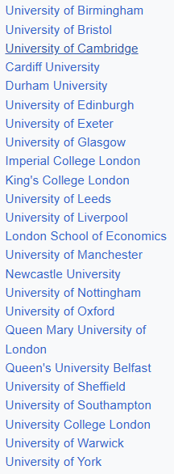
True or False?
You need A-levels for University
True
False
Many students who are go to one of the Russel group of Universities, do so through achieving A-levels. The majority need high grades with A and B grades essential. There are 24 Russel group Universities. However, many students get into Universities with other L3 qualifications and some mature students through relevant life experiences and skills.

Slide 10
True or False?
Universities and Employers do not care which A-levels you study
True
False
If you have a career path in mind, it’s important to check university entry requirements before applying as some universities require specific A levels. For example, if you want to apply for a science degree, a university will typically expect to see a science A level among your grades.
However, you might not know what career path you want to follow and that’s okay too. If you’re not yet sure about your university plans, it’s best to keep your options open by choosing a range of A-level subjects that play to your strengths and you enjoy studying

Slide 11
True or False?
I can do A-levels without GCSE’s
True
False
In order to study A levels, you will need five GCSEs graded 9-4, including English and Maths (or equivalent) and three additional GCSE qualifications at grade 9-4 or BTEC equivalents. Grade 4 is equivalent to a grade C. Some providers may also ask that for an A-level you are choosing, you achieve a 5 or a 6 in the GCSE for the same subject. It is important to check entrance requirements. This is sensible as if I am wanting to do Art at A-level, I would find this difficult if I had not achieved a high standard 6+ at GCSE level.

Slide 12
True or False?
A-levels give you many options at the end of Year 13.
True
False
A-levels are recognised as a valuable qualification and a good measure of Academic ability. You will end Year 13 more mature and with useful knowledge and skills. So therefore many students go on to higher education after studying A levels, but others choose to do an apprenticeship or enter employment.
The good news is that there are a range of careers that don’t require a degree or higher education. In fact, many sectors even train you from within the career, like the police, civil service, construction, hospitality industry or professions like dental hygienists, pharmacy technicians and administrators.

Slide 13
True or False?
A-levels cannot be combined with other subjects
True
False
Many Sixth Forms and Colleges allow hybrid courses, where you can combine 1 or 2 A-levels with other courses. These courses are normally vocational courses like L3 Applied BTEC and Diploma courses. You will combine your UCAS points from all your Hybrid courses to access University courses.

Slide 14
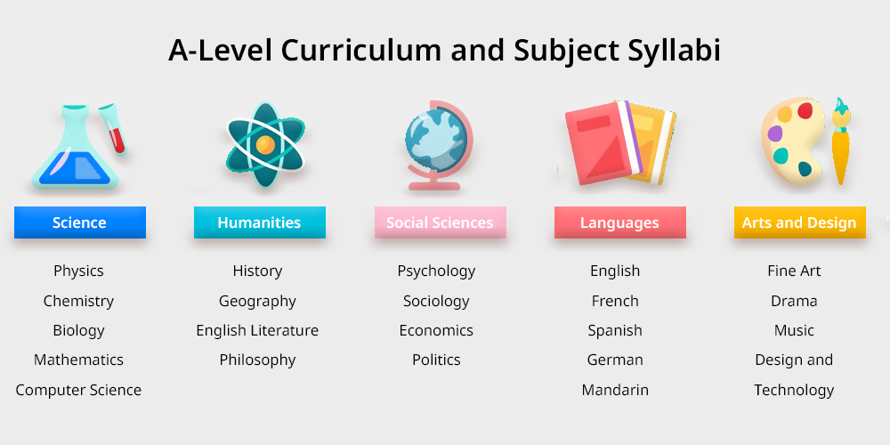
True or False?
There are only a few different A-level courses available.
True
False
There are 85 different A-levels available but most Sixth Forms and College offer a much smaller selection. For example, check out the subjects at:
New College Bradford – Link
Leeds City College - Link

Slide 15
Case Study
Harlow is wanting to study medicine at University. The A-level subjects being considered are Biology, Mathematics and History. Is this a sensible choice?
Harlow will struggle to get into many Medical Schools, especially at Russell group Universities who frequently see Chemistry as a must have A-level with any two from Mathematics, Physics or Biology. However, there are always exceptions, and it is important to gain as much advice as possible from your College or Sixth Form before deciding your A-level subjects.

Slide 16
Further work
Research three A-level subject and look at a number of key areas:
What you study?
How you will study, is it all classroom-based?
How you will be assessed and tested?
What careers link well with each of those A-levels.

Slide 17
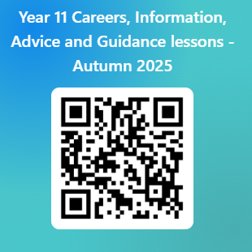
Please use this link below or the QR code to give us feedback on the lesson and suggest any improvements or additions.
https://forms.office.com/e/TXBtt1aDkc

Slide 18


